Slide 1

Titrating Strong Acids and Strong Bases
Consider the titration of 50.0 mL of 0.100 M HCl with 0.200 M NaOH
The only equilibrium reaction of importance is
H₃O⁺(aq) + OH–(aq) 2H₂O(l)
To construct the titration curve, calculate the volume of NaOH needed to reach the equivalence point.
At the equivalence point
Moles HCl = moles NaOH
M_{a}V_{a} = M_{b}V_{b}

Slide 2


Strong acid-strong base
The volume of NaOH needed to reach the equivalence point is
Before the equivalence point, HCl is present in excess and the pH is determined by the concentration of excess HCl
Initially the solution is 0.100 M in HCl, which, since HCl is a strong acid, means that the pH is
pH = –log[H₃O⁺] = –log[HCl] = –log(0.100) = 1.00
The equilibrium constant for reaction is (Kw) ^{–1}, or 1.00 x 10¹⁴. For this large value we can assume that the reaction goes to completion. After adding 10.0 mL of NaOH, therefore, the concentration of excess HCl is

Slide 3
Strong acid-strong base
At the equivalence point the moles of HCl and the moles of NaOH are equal.
Since neither the acid nor the base is in excess, the pH is determined by the dissociation of water.
K_{w} = 1.00 x 10^{–14} = [H³O⁺][OH–] = [H₃O⁺]²
[H₃O⁺] = 1.00 x 10^{–7} M
Thus, the pH at the equivalence point is 7.00.

Slide 4
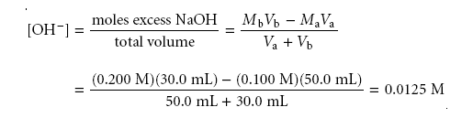
Strong acid-strong base
Finally, for volumes of NaOH greater than the equivalence point volume, the pH is determined by the concentration of excess OH–.
For example, after adding 30.0 mL of titrant the concentration of OH– is

Slide 5

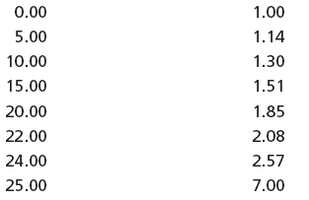
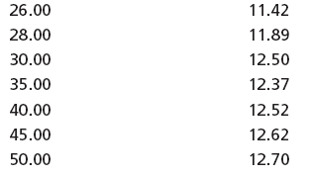
Strong acid-strong base
To find the concentration of H₃O⁺, we use the K_{w} expression

Slide 6

Titrating a Weak Acid with a Strong Base
Consider the titration of 50.0 mL of 0.100 M acetic acid, CH₃COOH, with 0.100 M NaOH.
Calculating the volume of NaOH needed to reach the equivalence point
Moles CH₃COOH = moles NaOH
M_{a}V_{a} = M_{b}V_{b}

Slide 7


Weak Acid - Strong Base
Before adding any NaOH the pH is that for a solution of 0.100 M acetic acid
Since acetic acid is a weak acid, we calculate the pH using the method of K_{a}
CH₃COOH(aq) + H₂O(l) H₃O⁺(aq) + CH₃COO–(aq)

Slide 8

Weak Acid - Strong Base
Adding NaOH converts a portion of the acetic acid to its conjugate base.
CH₃COOH(aq) + OH–(aq) H₂O(l) + CH₃COO–(aq)
Any solution containing comparable amounts of a weak acid, HA, and its conjugate weak base, A–, is a buffer.
The pH can be calculated by using the Henderson–Hasselbalch equation.

Slide 9


Weak Acid - Strong Base
The equilibrium constant for the reaction is large
(K = K_{a}/K_{w} = 1.75 x 10⁹), so the reaction can be considered as going to completion.
Before the equivalence point, the concentration of unreacted acetic acid is
and the concentration of acetate is

Slide 10
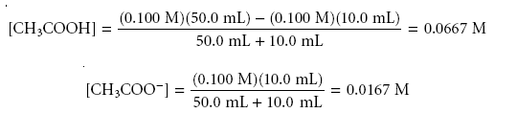

Weak Acid - Strong Base
For example, after adding 10.0 mL of NaOH the concentrations of CH₃COOH and
CH₃COO– are
And

Slide 11

Weak Acid - Strong Base
At the equivalence point, the moles of acetic acid initially present and the moles of NaOH added are identical
Since their reaction effectively proceeds to completion,
the predominate ion in solution is CH₃COO–, which is a weak base. To calculate the pH we first determine the concentration of CH₃COO–.

Slide 12

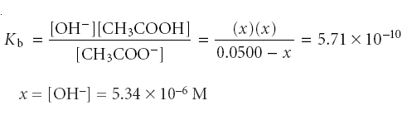
For a weak base
[H₃O⁺] = K_{w} x [OH⁻]⁻¹ = 1.87 X10⁻⁹
pH = 8.73

Slide 13

Weak Acid - Strong Base
After the equivalence point NaOH is present in excess For example, after adding 60.0 mL of NaOH, the concentration of OH– is
pH = 11.96

Slide 14
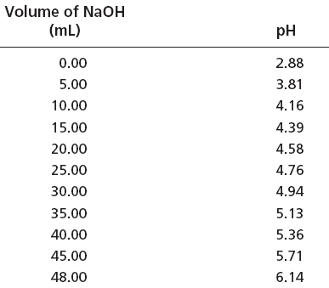
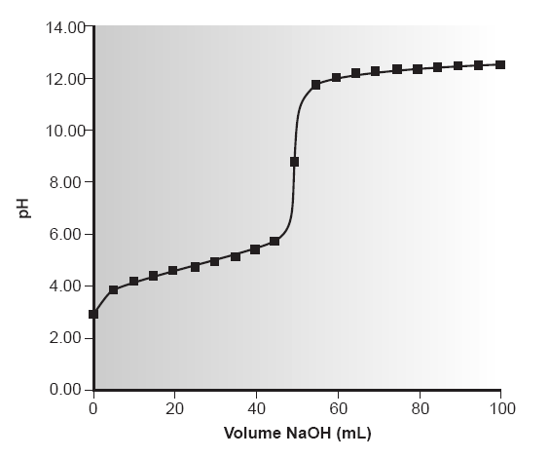

Slide 15
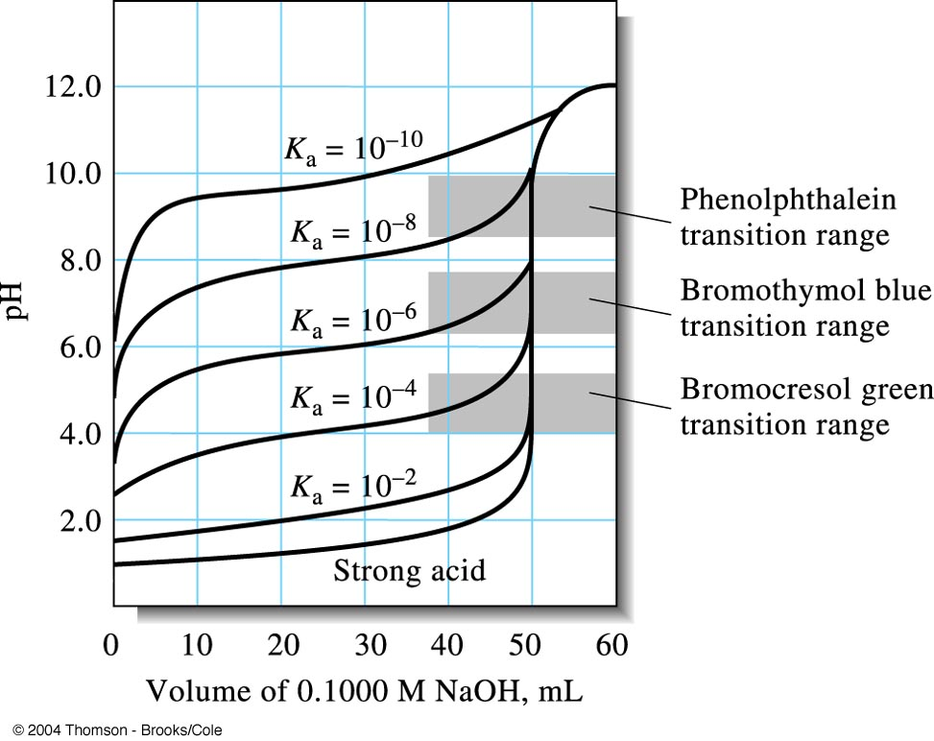
The effect of acid strength on titration curves.
Each curve represents the titration of 50.00 ml of 0.1000 M acid with 0.1000 M base.

Slide 16
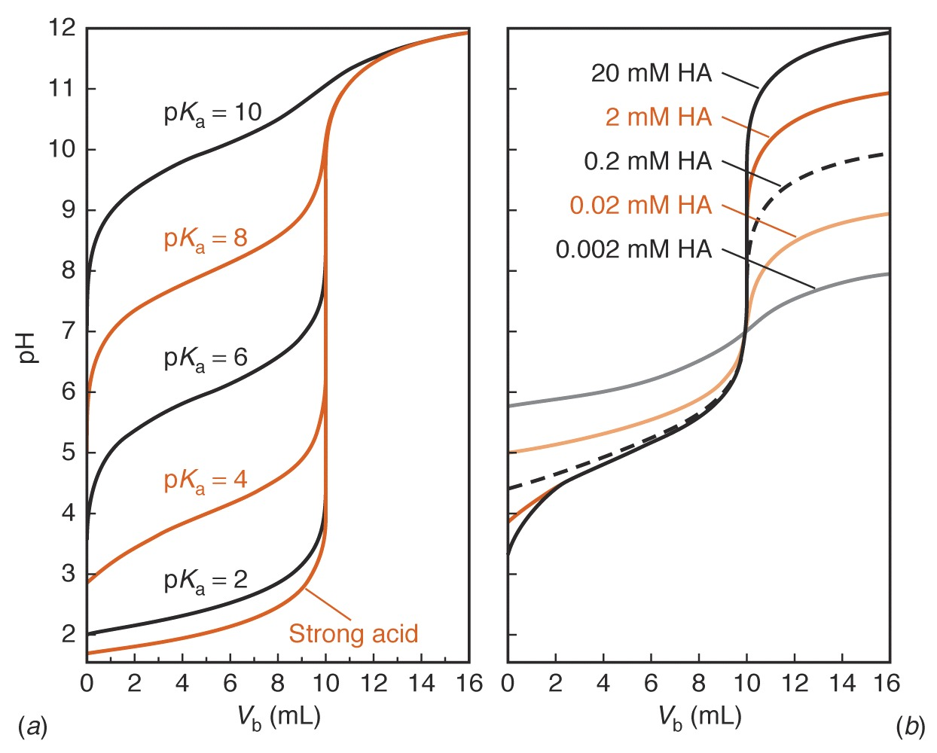
Calculated curves showing the titration of 50.0 mL of 0.0200M HA with 0.100M NaOH.
Calculated curves showing the titration of 50.0 mL of HA with NaOH whose concentration is five times greater than that of HA.

Slide 17
Applications
1. Acidity for the examination of water and wastewater :
Acidity as mg CaCO₃/L ={ N_{NaOH} ×Vml_{NaOH} – N_{H2SO4}× Vml_{H2SO4}}/ Vml_{sample}
2. Titratable acidity in food sample :
% acidity = {N_{NaOH} × Vml_{NaOH} × Eq.wt.(mg/Eq.)_{Acid}}/ Wt(mg)_{sample}
3. Salicylic acid, Benzoic acid, Organic acids
4. Sorenson formol titration : ex. protein hydrolysate ;
the free amino acid is treated with formaldehyde to form the methylimino or methylol derivative, reducing the basicity of the amino group so that the free carboxyl group may be titrated.
R—CH(NH₂)COOH + HCHO = R—CH(NHCH₂OH)COOH
or R—CH(N=CH₂)COOH
5. Kjeldahl nitrogen analysis

